Slide 1


Slide 2
Code conversion
Code conversion is the process of changing data or software from one format, code, or language to another.
CIT,2 YEAR ELT-II

Slide 3
DECIMAL TO BINARY CONVERSION
BINARY TO DECIMAL CONVERSION
DECIMAL TO BCD CONVERSION
BCD TO BINARY CONVERSION
OCTAL TO DECIMAL CONVESION
DECIMAL TO OCTAL CONVERSION
HEX TO BINARY CONVERSION
BINARY TO HEX CONVERSION
BINARY TO GREY CONVERSION
GREY TO BINARY CONVERSION
CIT,2 YEAR ELT-II

Slide 4
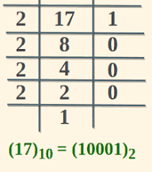
CIT,2 YEAR ELT-II

Slide 5
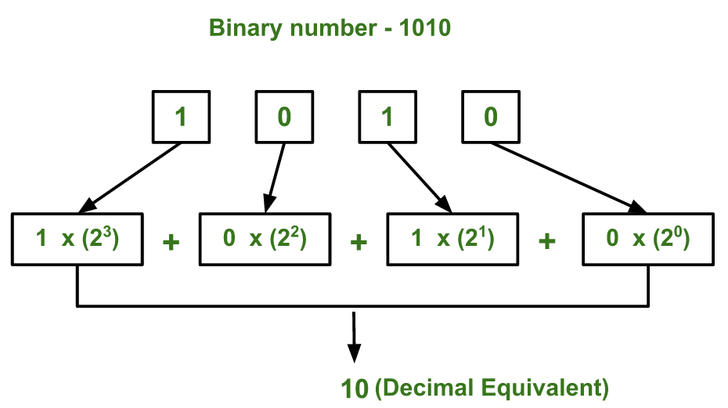
CIT,2 YEAR ELT-II

Slide 6
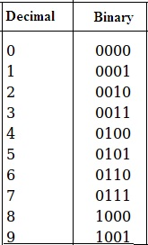
CIT,2 YEAR ELT-II

Slide 7
CIT,2 YEAR ELT-II

Slide 8
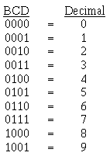
CIT,2 YEAR ELT-II

Slide 9
For example, let's go through the conversion of 264₁₀ to BCD.
2 = 0010
6 = 0110
4 = 0100
The BCD equivalent of 264 is 001001100100.
To convert from BCD to decimal, simply reverse the process as shown:
1001 = 9
1000 = 8
0011 = 3
CIT,2 YEAR ELT-II

Slide 10
Convert (0011 0101)BCD to Binary
Group: (0011) (0101)
Nibble to Decimal:
0011 = 3
0101 = 5
Form Decimal: The decimal number is 35.
Decimal to Binary (35):
35 ÷ 2 = 17 R 1
17 ÷ 2 = 8 R 1
8 ÷ 2 = 4 R 0
4 ÷ 2 = 2 R 0
2 ÷ 2 = 1 R 0
1 ÷ 2 = 0 R 1
Reading remainders from bottom to top: 100011.
So, (0011 0101)BCD = (100011)₂.
CIT,2 YEAR ELT-II

Slide 11
CONVERT BINARY TO BCD
Binary 1101101 (109 in decimal)
Binary 1101101 = (1*64) + (1*32) + (0*16) + (1*8) + (1*4) + (0*2) + (1*1) = 109 (decimal).
Separate digits: 1, 0, 9.
Convert each: 1 -> 0001, 0 -> 0000, 9 -> 1001.
Concatenate: 0001 0000 1001
CIT,2 YEAR ELT-II

Slide 12
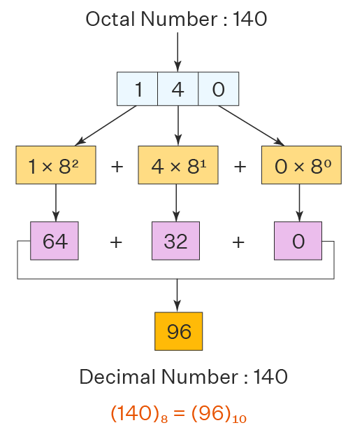
CIT,2 YEAR ELT-II

Slide 13
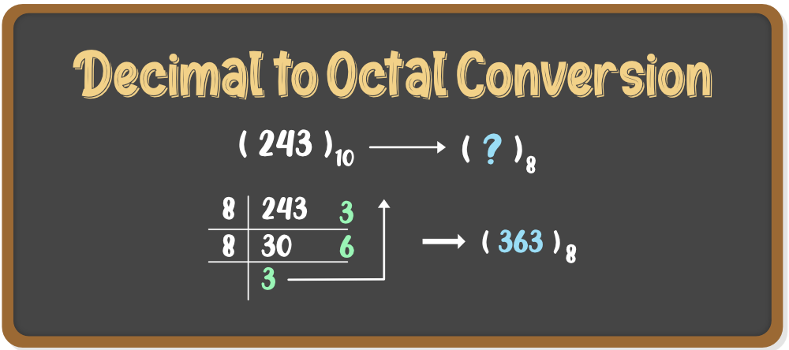
CIT,2 YEAR ELT-II

Slide 14
Conversion Table:
0 = 0000
1 = 0001
2 = 0010
3 = 0011
4 = 0100
5 = 0101
6 = 0110
7 = 0111
8 = 1000
9 = 1001
A (10) = 1010
B (11) = 1011
C (12) = 1100
D (13) = 1101
E (14) = 1110
F (15) = 1111
Convert Hex 2F to Binary
2: Convert 2 to binary: 0010.
F: Convert F (15) to binary: 1111.
Combine: 0010 + 1111 = 00101111.
So, 2F (Hex) is 00101111 (Binary).
CIT,2 YEAR ELT-II

Slide 15
Convert 1101011101 to Hex
Group: 1101 0111 01 (Add leading zeros to the first group) -> 0011 0101 1101.
Convert:
0011 = 3
0101 = 5
1101 = D
Combine: 35D. So, 1101011101 (binary) = 35D (hexadecimal).
CIT,2 YEAR ELT-II

Slide 16
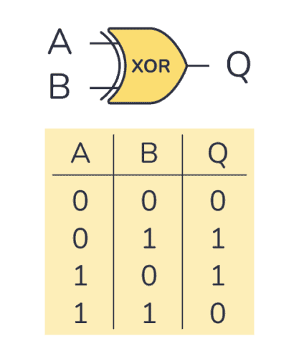
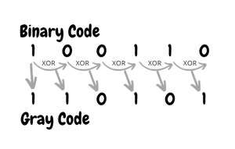
CIT,2 YEAR ELT-II

Slide 17
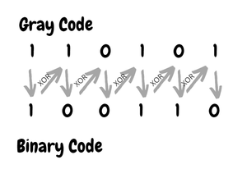
CIT,2 YEAR ELT-II

